Slide 1
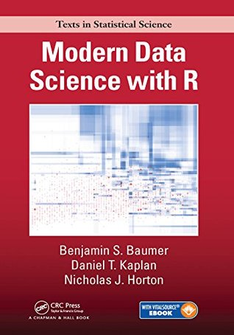
Get your raffle ticket now!
Win the book
Modern Data Science with R
Hard cover book and e-book
582 pages
Ticket Price:
$1 for a single ticket
$5 for 10 tickets (value deal)

